Slide 1
Analyzing Data in MWADC

Slide 2
Outline
What is Ravian and what is the Analyst application?
Accessing the Analyst application
What you can do with the Analyst role?
Advanced analyses in MWADC
Developing your own analyses and visualizations in MWADC

Slide 3
What is Ravian?
Ravian is a server-based analysis package for visualizing AKN data
Developed by Point Blue Conservation Science in the open-source statistical programming language R
Uses warehoused data (known type and characteristics data, apples-to-apples)
Three main levels of use: fixed pre-designed analyses, flexible exploration and analysis development, and advanced analyses

Slide 4
What is the Analyst?
The Analyst is a user interface for simple data visualizations using Ravian
Designed for project leaders and people with some knowledge about the data
Password-protected access
Intended to help develop project reports

Slide 5
Step 8: Analyze Observations
Assign Protocols and/or Create New Protocols
Add Events and Observations
Create a Project
Create Sampling
Units
Add Researchers and/or Have People Register
Proof Events and Observations
Assign AKN Data Sharing Level
Analyze Observations
http://data.prbo.org/apps/analysts
Segregated by data collection methodology.
x

Slide 6
Working with the Analyst Getting there…

Slide 7
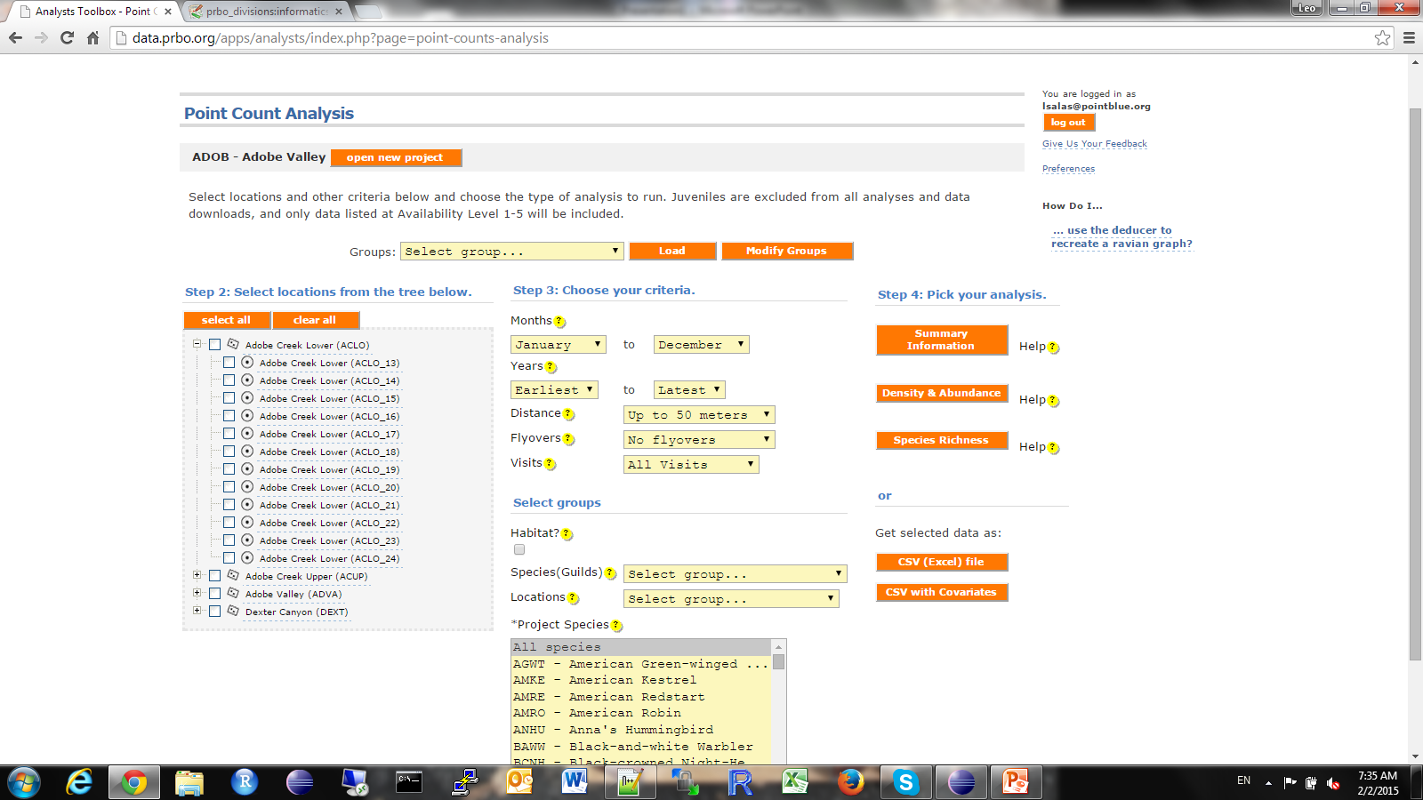
Working with the Analyst Dashboard
Change projects
Filter by month and year
Filter by distance
Select locations
Exclude fly-overs
Filter by visits
Select one or multiple taxa

Slide 8
Working with the Analyst Dashboard
Other features include:
Setting, saving and using taxon groups or guilds (obtain results for a guild as a single estimate)
Setting, saving and using customized selection of locations (e.g., remove points from transect before requesting a transect estimate)
Setting, saving and using observation groups (e.g., compare observations in marsh habitat vs. transition habitat)
Download warehouse data (for DIY analysts out there)

Slide 9
Working with the Analyst Data summaries
Results are downloadable
Basic summaries include:
Descriptions of survey effort (numbers and dates of visits to each location)
Description of observations (number of detections by month and year, by taxa and month/year)
Hill series diversity indices for the entire set (richenss, Shannon, Simpson, evenness)

Slide 10
Working with the Analyst Density and abundance estimation
Simple density estimation
(average among visits to points/plots/nets and within transects/banding stations – error estimates are good approximations but underesimated)
Tabular and graphic results
Trend estimation (linear and GAM plots)

Slide 11
Working with the Analyst Richness estimation
Simple richness estimation
(average among visits to points/plots/nets and within transects/banding stations – error estimates are good approximations but underesimated)
Tabular and graphic results
Trend estimation (linear and GAM plots)

Slide 12
Advanced analyses in MWADC Geek alert!
What?
Advanced analyses, required periodically (e.g., annually) for specific purposes (adaptive mgt.)
How?
Use your R interface to request data
Develop your analysis methods
Post the methods in MWADC
Use your R interface to run them
Get results via e-mail
Example above fits a BUGS/JAGS model…

Slide 13
Developing your own applications Geek alert!
Next iteration of Ravian will allow sourcing of “wrapper” code.
You could then:
Download your sample data from Analyst warehouses
Write your own analysis methods
Encapsulate them in a wrapper function to be sourced by Ravian
Post the wrapper in MWADC
Develop (or let us help you develop) a user interface to use your methods
Results will be displayed on-line in a browser, with all the features of Analyst results (dynamic, downloadable tables, downloadable graphs)
Results can be converted to javascript by Ravian.

